Slide 1
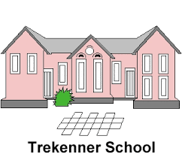
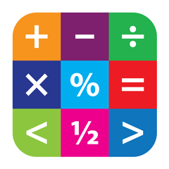
Parent Maths Workshop
Key Stage Two
Mr Wheeler
Headteacher and Maths Co-ordinator

Slide 2
Aims of the Workshop
To remind parents of the the main changes to the new primary maths curriculum.
To introduce the new structure of mathematics teaching introduced this year.
To recap key principles of fluency, reasoning and problem solving.
TO provide parents with ideas and strategies they can use at home to support their children.

Slide 3
What are your memories of learning maths at school?

Slide 4
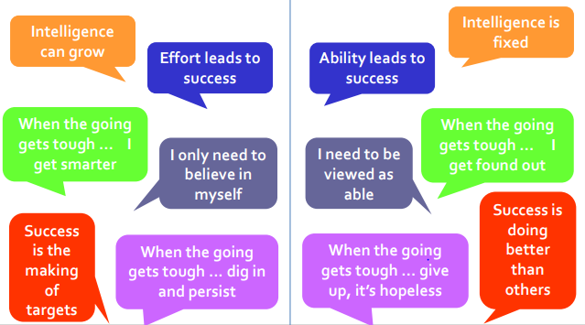
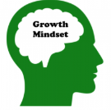
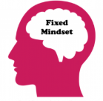
What are your memories of learning maths at school?
We believe that everyone can get better at maths…when they put in the effort and work at it.
Instead of praising children for ‘being clever’ when they succeed at something, we should be praising children for the efforts and perseverance!
Children learn to associate achievement with effort (which is something they can influence themselves – by working hard!), not ‘cleverness’ (a trait perceived as absolute and that they cannot change).

Slide 5
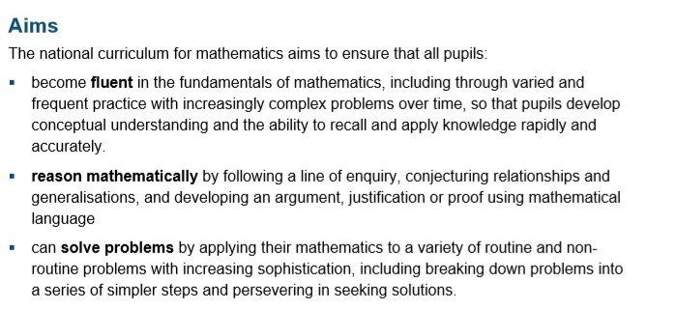

Slide 6
Key Differences of the maths curriculum:
Five-year-olds are expected to learn to count up to 100 (compared to 20 under the old curriculum) and learn number bonds to 20 (was up to 10).
Simple fractions (1/4 and 1/2) are taught from KS1, and by the end of primary school, children should be able to convert decimal fractions to simple fractions (e.g. 0.375 = 3/8) and calculate with fractions.
By the age of nine, children are expected to know times tables up to 12×12 (was 10×10 by the end of primary school).

Slide 7
Good practice in maths today!
Mental calculation skills are vital.
Children need the ability to estimate.
e.g. If I have 18 sweets in one bag
and 33 sweets in another bag,
how many do I have altogether.
Children can estimate by adding 20 and 30 and know that roughly the answer should be around 50.
Notes:
Two points are clear about what mathematical skills children need in life. Educationalists say that children today need to learn 2 key skills. The ability to calculate mentally and the ability to estimate.
Mental calculation skills are vital. Just have a think how often you use mental maths in your own lives.
Shopping- working out change. Working out how many packets of biscuits or crisps you need to buy for a children’s birthday party.
Working out how long it is before you need to leave to pick up children from school.
Working out how many days left to do all your Christmas shopping?
A lot of maths in life is done in your head.
But within that I hope that you’re also estimating. When working out how long you have until you need to come to school, you round to the nearest hour or half hour.
So in school, we encourage children to estimate. If they are faced with a problem. I have 18 sweets in 1 bag and 33 in another bag. How many in total? Children in maths lessons today would be encouraged to round to the nearest 10 in their head and work out 20 add 30 to approximate an answer.
Alongside the ability to estimate, Educationalists today also say that children need to develop other key skills in maths.
Childrern need to learn maths in a context. Therefore in school we aren’t just giving children lists of sums to complete. We are asking them to really think. Research shows that many children who can tell you what 7 x 7 = 49 cannot answer a question in a real life context. E.g. There are 7 fields, each has 7 sheep in them. How many sheep are there altoghether.
Children need to be able to explain. What they are doing.
You may well say well what about the written calculations. Well these are still taught, but there is a balance. At St Luke’s we certainly would expect children by the time they leave school to know, understand and use a written strategy for more complex maths calculations but emphasis early on is placed on mental calculations.
If we look at the next slide, this will hopefully illustrate the point in hand.

Slide 8
Good practice in mathematics
All children need to learn maths in a real life context.
As well as knowing 7x7=49. Children need to be able to do the following:
There are 7 fields, each field has
7 sheep in them. How many sheep
are there in total?
Children need to be able to explain how they have calculated or solved a problem.
In the new curriculum, written calculations are taught at an earlier age. The mental methods are essential for supporting pupils understanding of these written calculations.
Notes:
Two points are clear about what mathematical skills children need in life. Educationalists say that children today need to learn 2 key skills. The ability to calculate mentally and the ability to estimate.
Mental calculation skills are vital. Just have a think how often you use mental maths in your own lives.
Shopping- working out change. Working out how many packets of biscuits or crisps you need to buy for a children’s birthday party.
Working out how long it is before you need to leave to pick up children from school.
Working out how many days left to do all your Christmas shopping?
A lot of maths in life is done in your head.
But within that I hope that you’re also estimating. When working out how long you have until you need to come to school, you round to the nearest hour or half hour.
So in school, we encourage children to estimate. If they are faced with a problem. I have 18 sweets in 1 bag and 33 in another bag. How many in total? Children in maths lessons today would be encouraged to round to the nearest 10 in their head and work out 20 add 30 to approximate an answer.
Alongside the ability to estimate, Educationalists today also say that children need to develop other key skills in maths.
Childrern need to learn maths in a context. Therefore in school we aren’t just giving children lists of sums to complete. We are asking them to really think. Research shows that many children who can tell you what 7 x 7 = 49 cannot answer a question in a real life context. E.g. There are 7 fields, each has 7 sheep in them. How many sheep are there altoghether.
Children need to be able to explain. What they are doing.
You may well say well what about the written calculations. Well these are still taught, but there is a balance.
Research shows that teaching children written procedures at too early a stage in their mathematical development can have an adverse effect upon their ability to operate mentally.
In line with many other countries, mental calculation skills are being taught and focussed upon, and the introduction of written methods are delayed until children are ready. At St Luke’s we certainly would expect children by the time they leave school to know, understand and use a written strategy for more complex maths calculations but emphasis early on is placed on mental calculations.
If we look at the next slide, this will hopefully illustrate the point in hand.

Slide 9
Good practice in mathematics
Connections are made between mathematics topic areas, other subjects and between objectives.
Children are taught to reason mathematically so that they able to consider if their answers are plausible.
Children are taught to consider the most effective calculation method and approach to calcualtions.

Slide 10

Problem solving
Fluency
Reasoning
A mathematician?
Notes:
Be aware of which children you need to meet floor targets of 65% in all 3 subjects.
Put it altogether with two digit number - 1 digit number = two digit number.
Discuss how using all three as they are all linked!

Slide 11
Our new teaching structure.
Children are introduced to the key procedures. They explore it through a range of mediums to help them to become fluent.
Do
Deepen
Children are exposed to deeper questions requiring them to reason and justify their ideas. They also begin to explore simple problems.
Apply
Children apply their understanding to a range of real life contexts and have the opportunity to explore more complex problems set in a range of contexts.

Slide 12
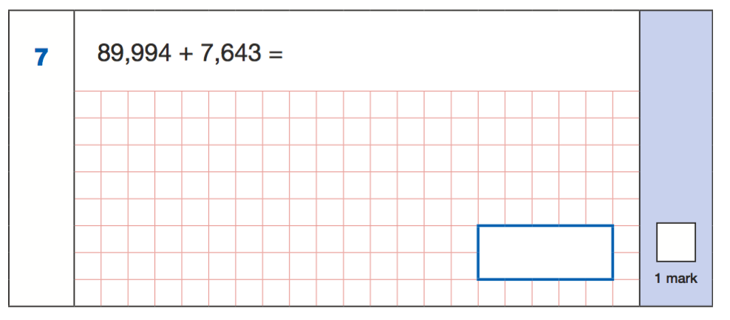
Focus on mental calculation

Slide 13
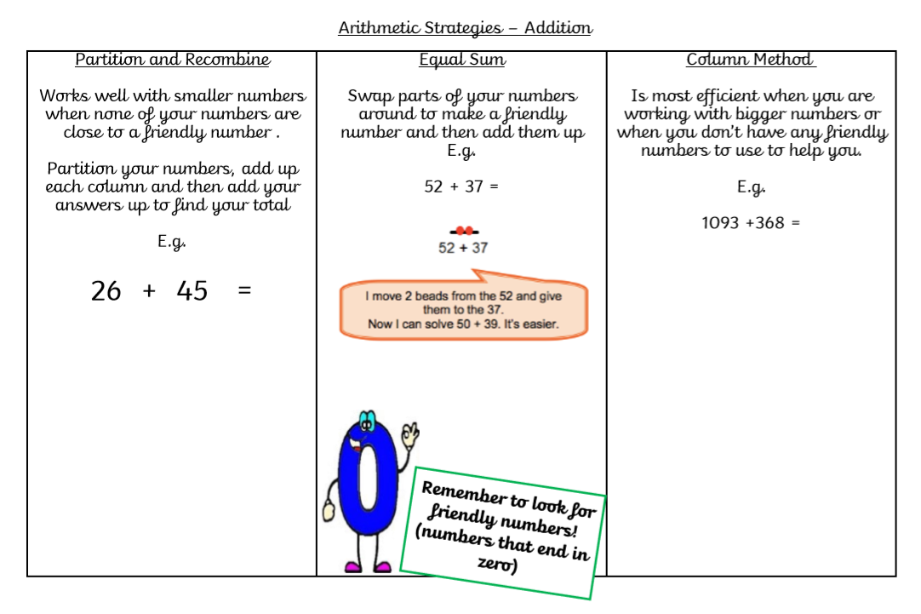
Focus on Mental calculation

Slide 14
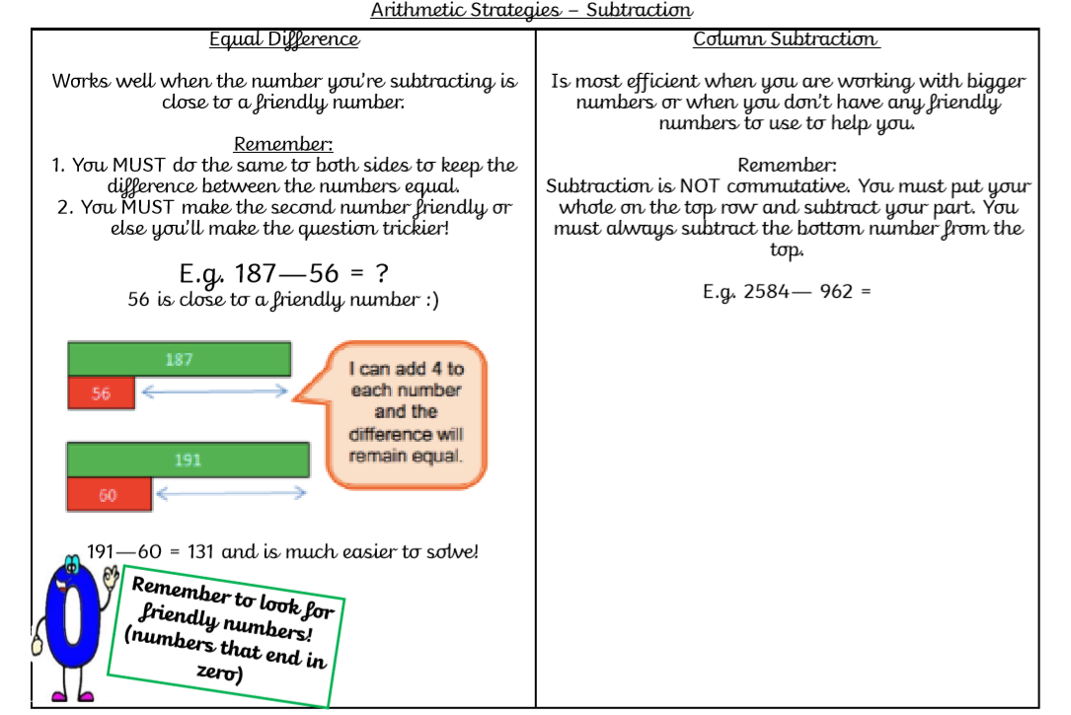

Slide 15
Multiplication
Doubles
1x2 1x4 1x8
1x3 1x6 1x9
Using patterns
I know 12x so 13 times is…

Slide 16
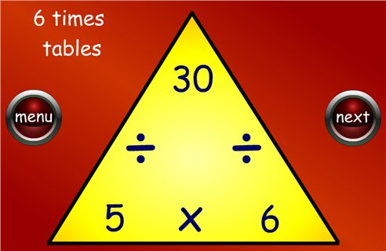
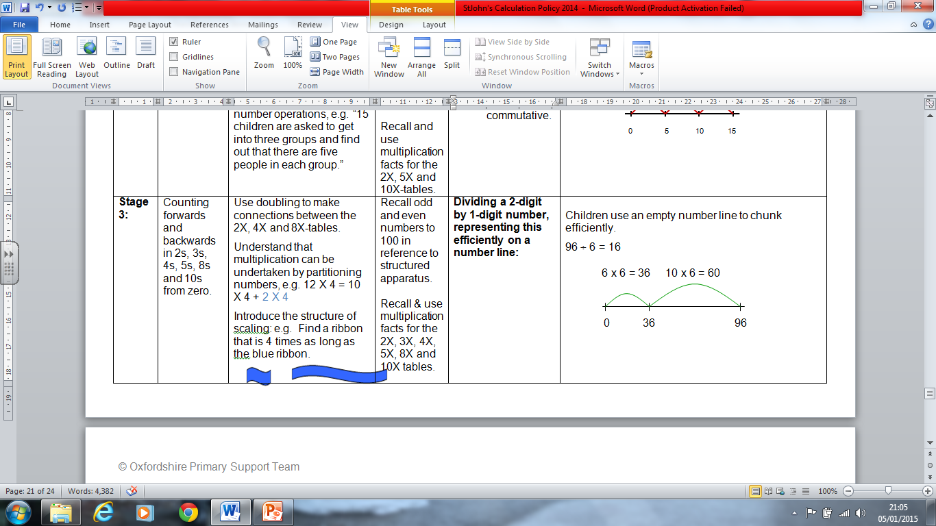
Division
Fact triangles.

Slide 17
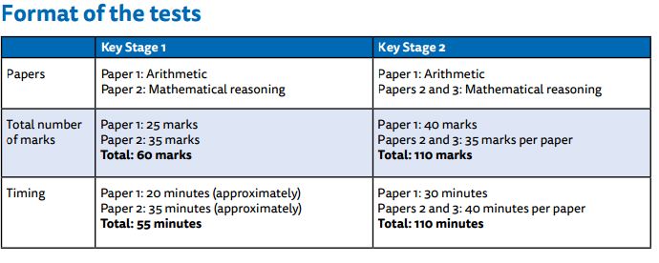
2016 SATs

Slide 18
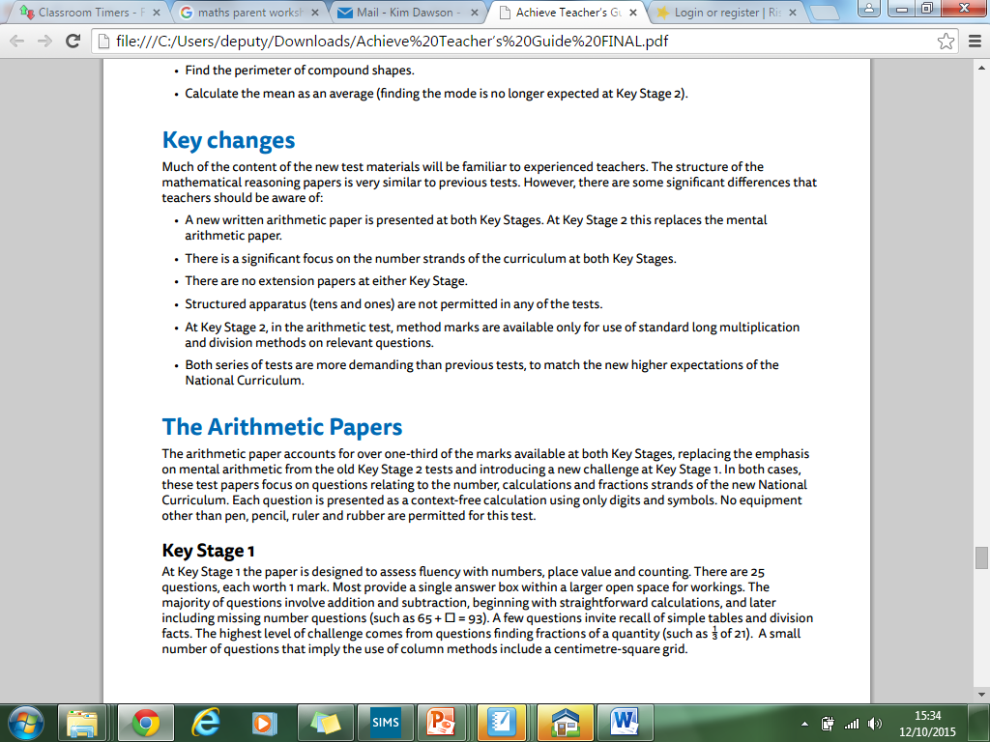
2016 SATs

Slide 19
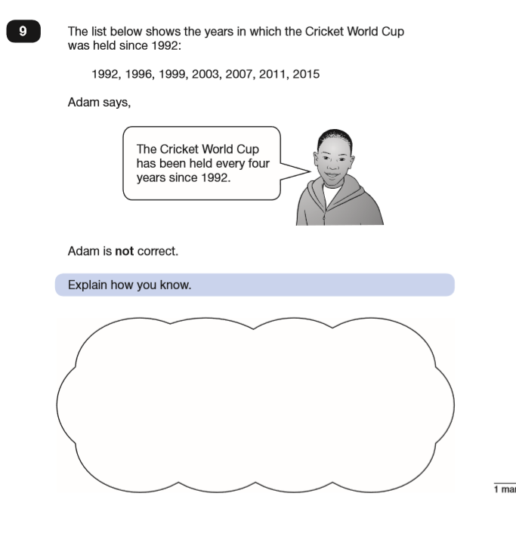
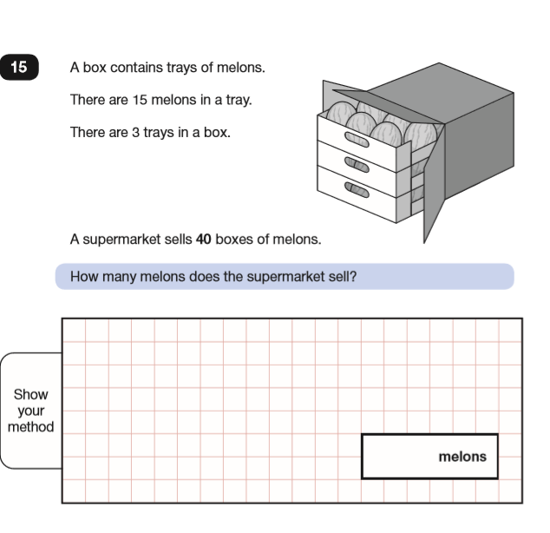
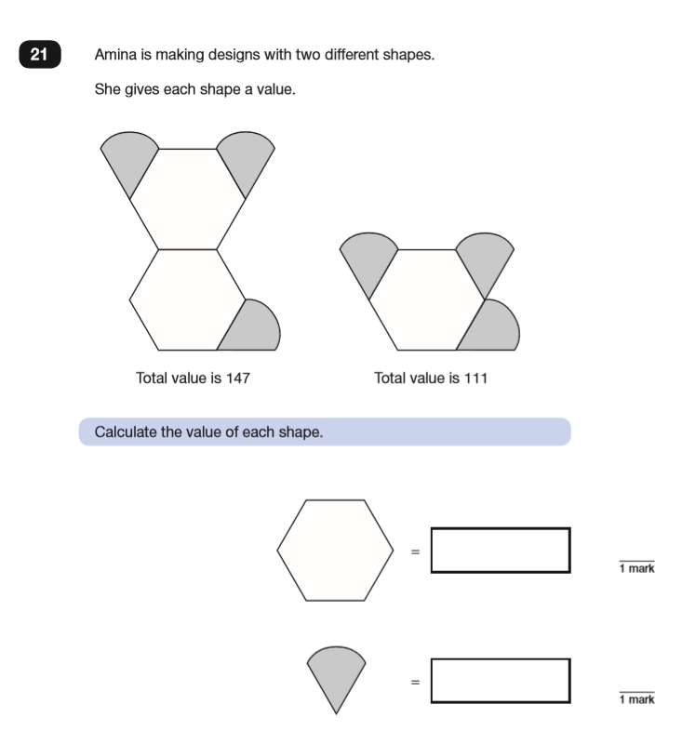

Slide 20
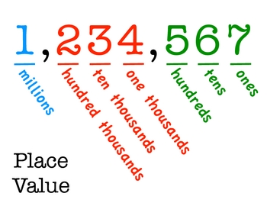
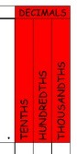
Place value

Slide 21
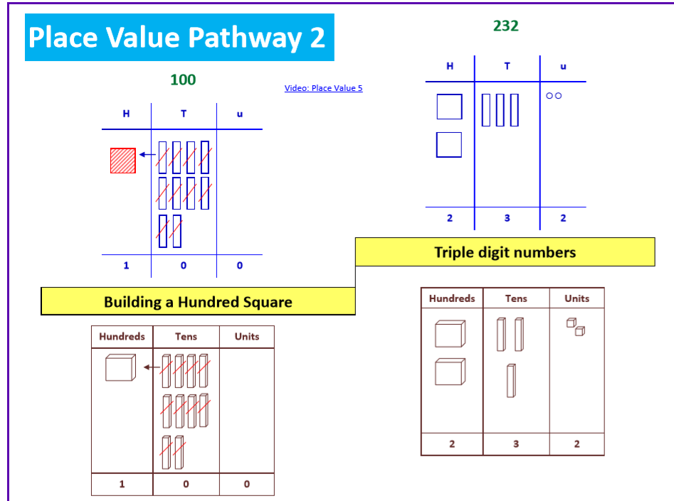
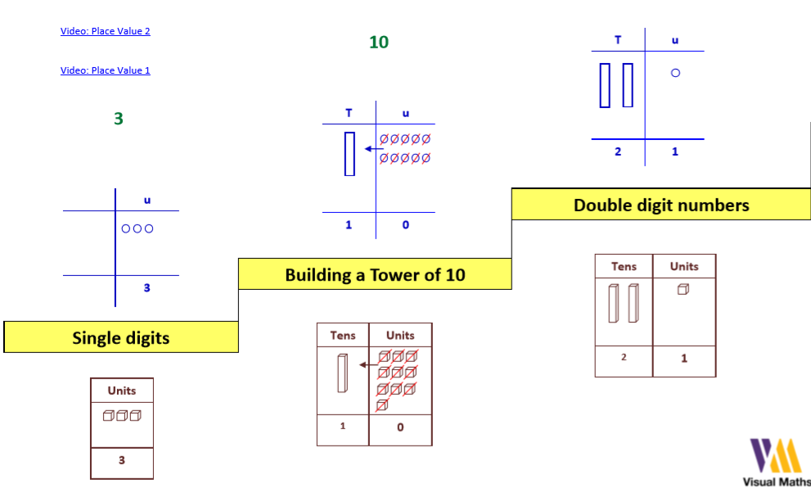
Place value

Slide 22


Slide 23
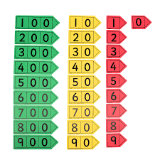
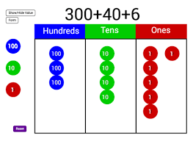
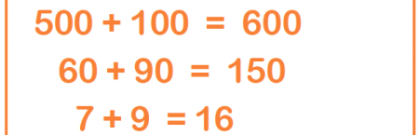
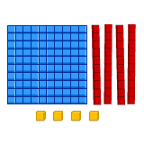
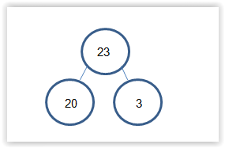

Slide 24
How many ways can you make…
4571

Slide 25
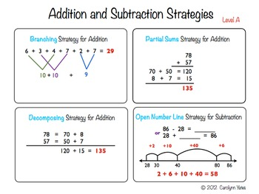
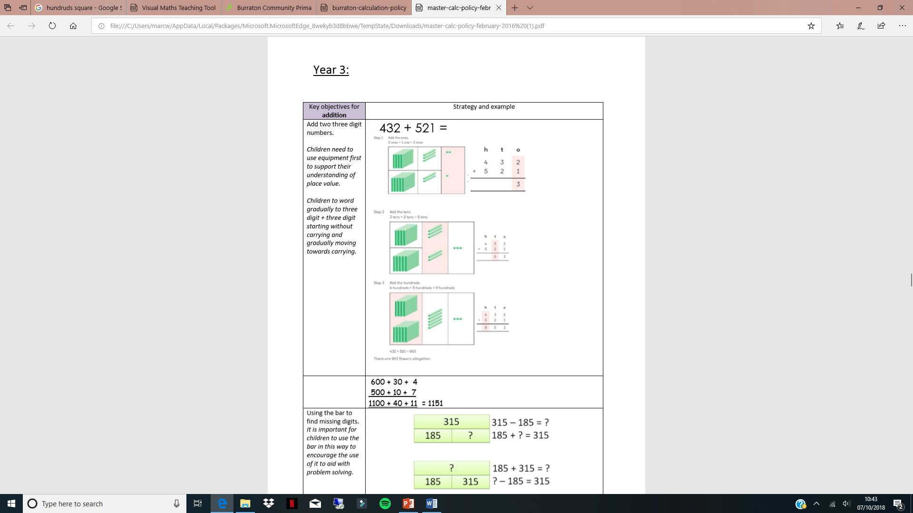
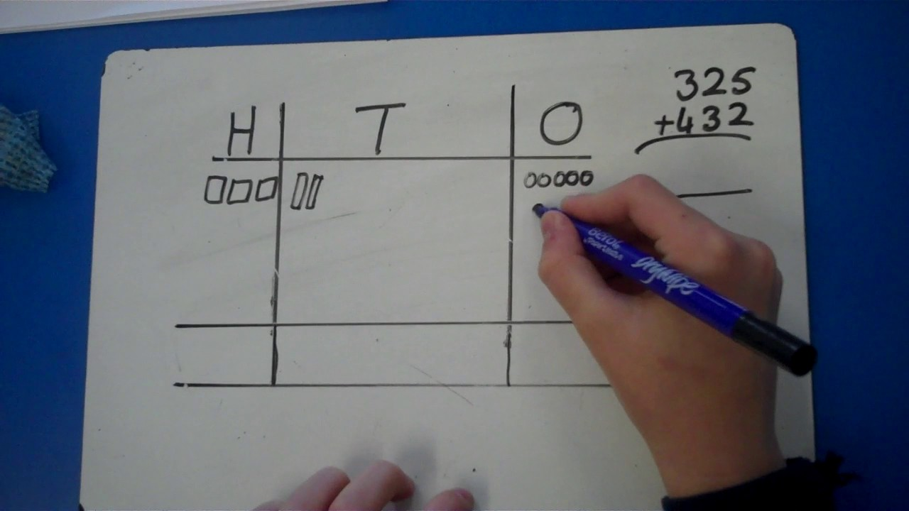
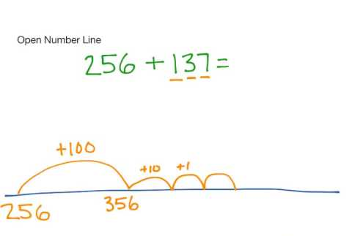
Addition

Slide 26
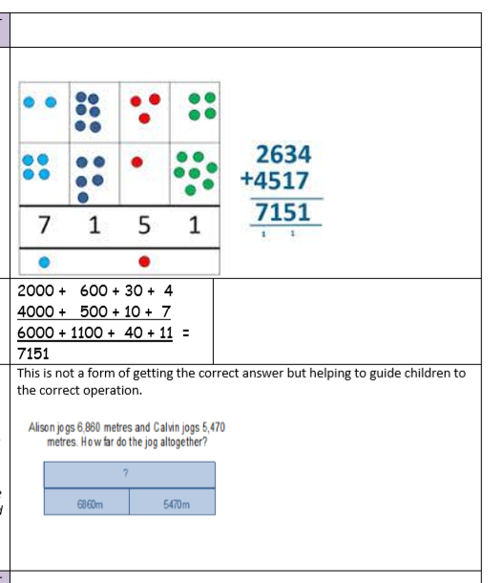
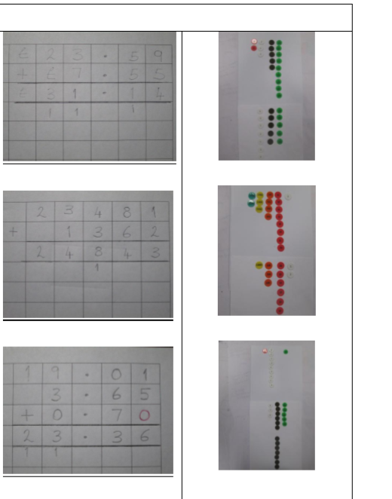

Slide 27
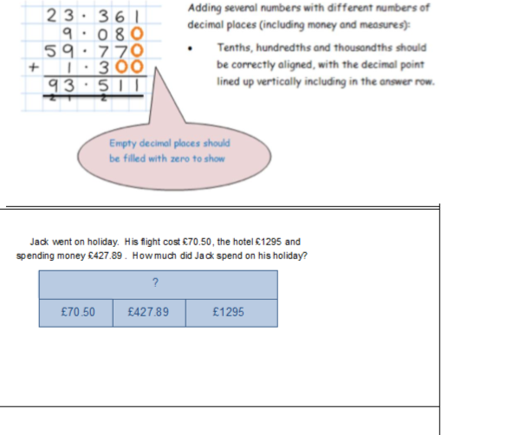

Slide 28
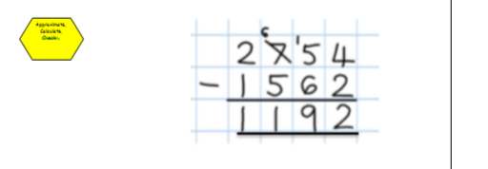
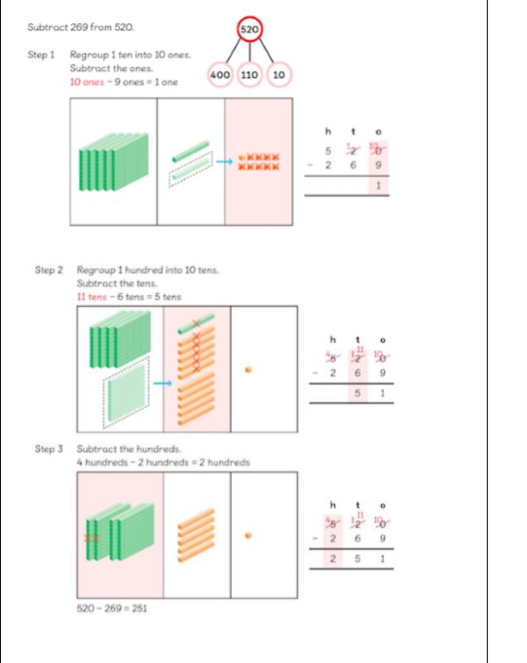
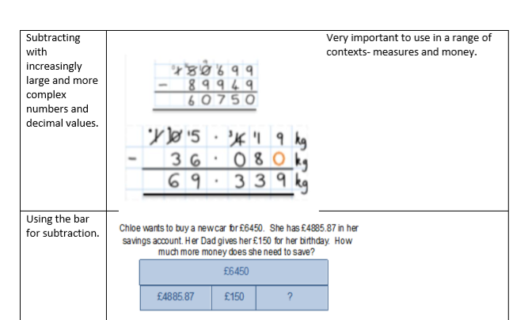
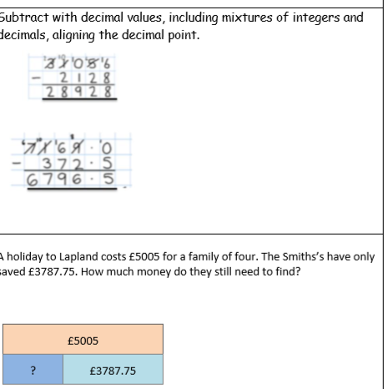
Subtraction

Slide 29
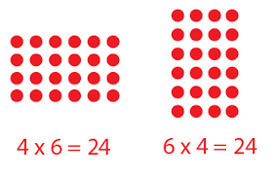
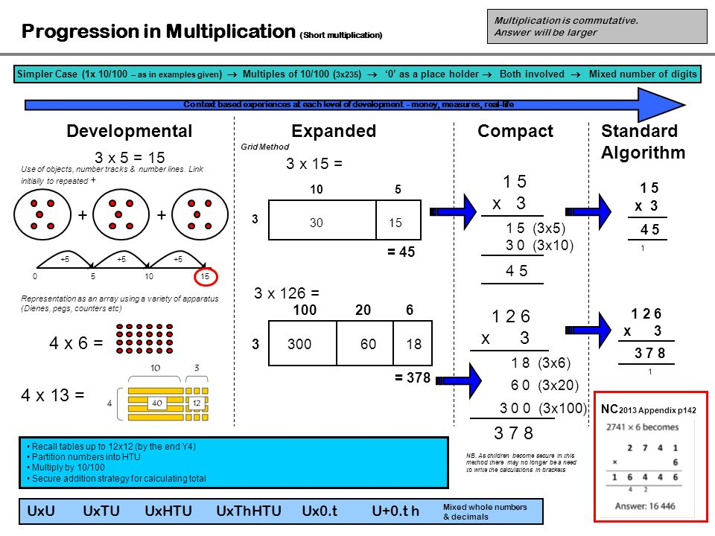
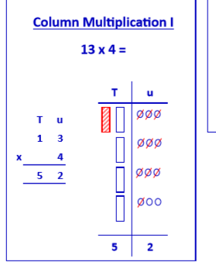
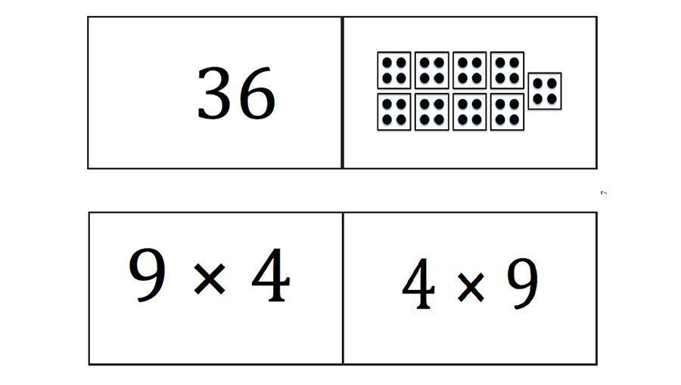
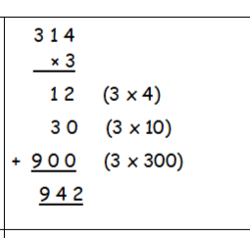
Multiplication

Slide 30
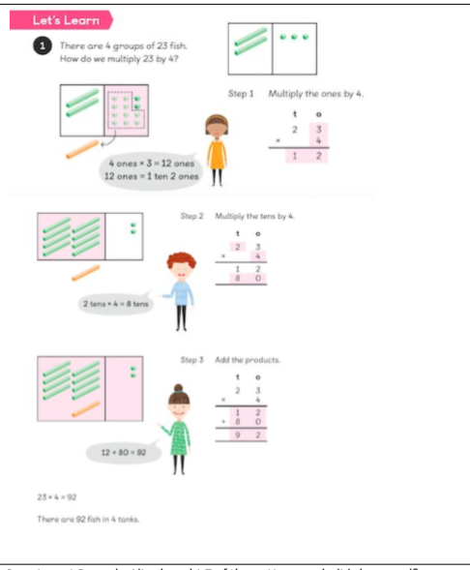
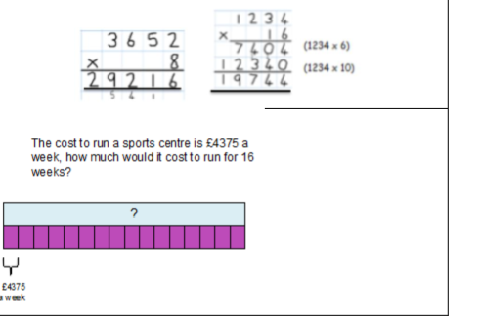
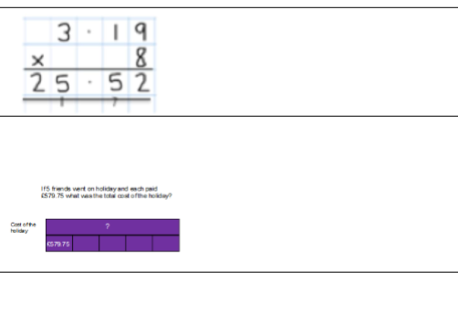

Slide 31
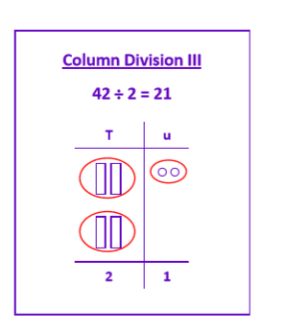
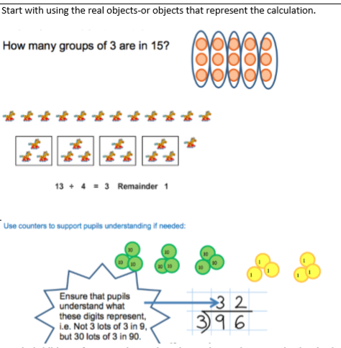
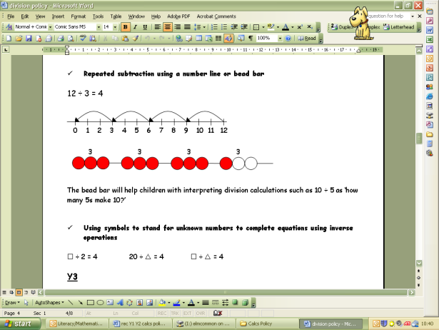
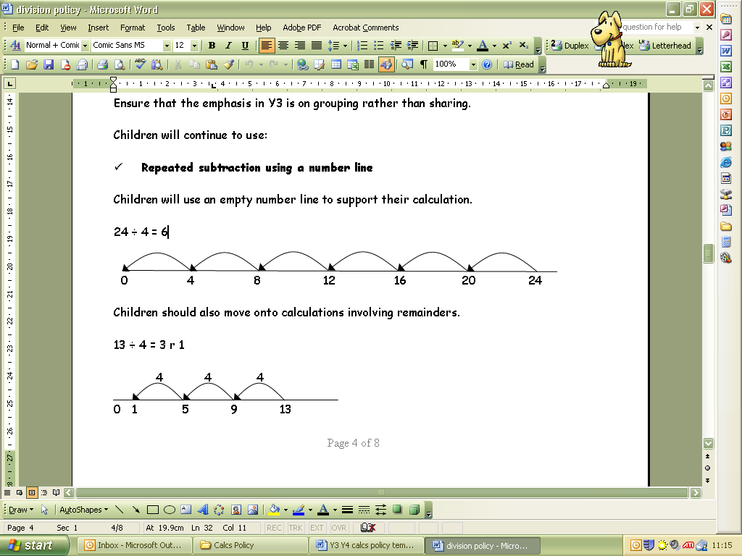
Division

Slide 32
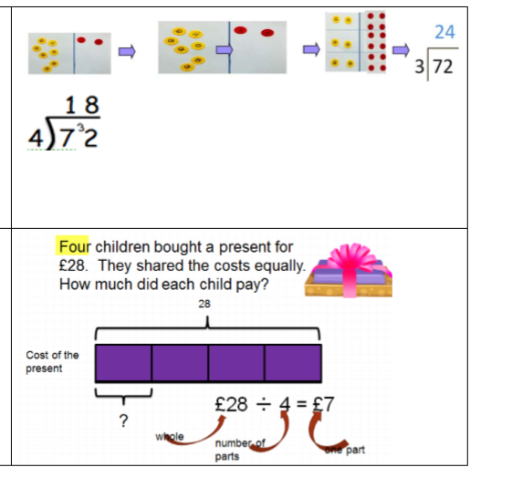
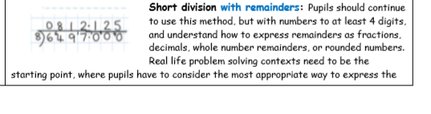



Slide 33




Fractions

Slide 34


+

Slide 35





Slide 36



Multiplying fractions

Slide 37


Dividing fractions

Slide 38


Reasoning

Slide 39


Slide 40

Bar Model

Slide 41

Bar model – pictorial representation of a problem
Notes:
Bar model can be both a concrete and pictorial representation of a problem.
We use numicon rods for the concrete representations (you will hear about an example using this resource soon)
In the model shown ‘a’ represents any number which is the whole amount. Therefore ‘b’ and ‘c’ represent numbers / the parts that together are the same amount as ‘a’.

Slide 42



Addition
Notes:
When children are given a word problem they need to identify what they know and what they don’t know out of the whole and the parts.
In the addition example, I have 6 red pencils and 4 yellow pencils, how many do I have?
The children can use their numicon rods or draw a picture to help them understand what operation is required for this problem.
They will see that they have two parts and need to identify the total number of pencils by putting the parts together.
You will have the opportunity to hear how else bar model can be used later and also during the maths lessons on Monday.

Slide 43


Slide 44
If two-thirds of a number is 90.
What’s the number?
90

Slide 45
Mum is 28 years older than Will. Mum is 4 years younger than Dad. Their total ages is 84 years.
28
Mum’s age
Will’s age
84
Dad’s age
4

Slide 46
Supporting your children at home
To ask children to explain how they have calculated something using a method that suits them.
Ensure children are confident with their multiplication facts and are fluent with simple mental calculation.
Talk to your child about their learning each day.
Discuss numbers you see around you: doors, buses, pictures in books, etc…
Encourage children to approach calculations in different ways. Show me a way, and another, and another…
Cooking and shopping with your child (use language more/less, share food for division, count food for addition)
Play (maths) with your child using board games (snakes and ladders) and online sites (Education City, BBC Bitesize, TopMarks).

